Slide 1

Equity & Engagement at NBRC
Director’s Introduction and Strategic Focus
Claudia Ritchie

Slide 2

Presentation Outline
Background
NBRC Journey
Role & Scope as Director of Equity & Engagement
Key Focus Areas

Slide 3
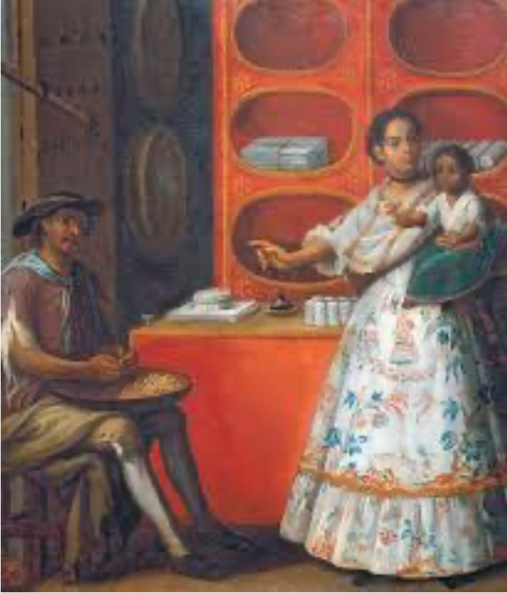
Background
• Born and raised in Mexico, lived in Morelia Michoacan prior to immigrating to the USA at the age of 17. I am the 4th of 8 siblings.
• Mixed heritage: Mother Mexican native & Father from Spain.
• Experienced privilege and discrimination in different stages of life. Both in Mexico and in USA
• First-hand knowledge & experience on inequities and systemic barriers.

Slide 4
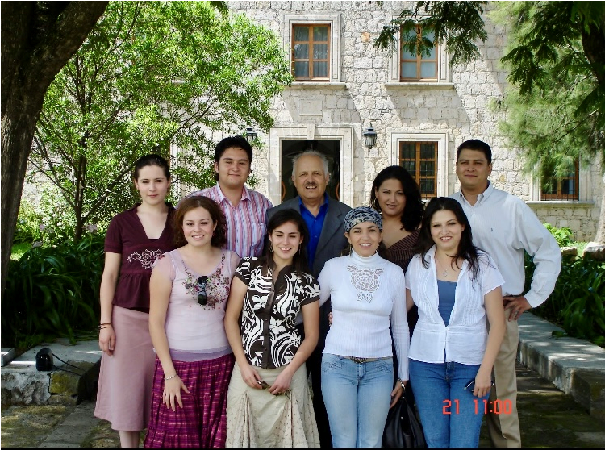
My 1st Home, Family, Language & Culture
Morelia

Slide 5

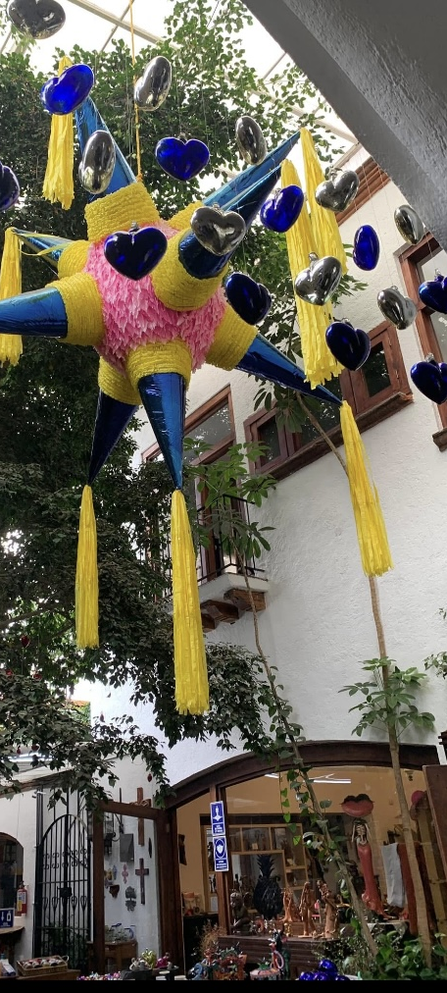
Culture & Traditions

Slide 6


Identity, Love & Gratitude Morelia UNESCO World Heritage
Mexico en la piel

Slide 7

NBRC JOURNEY
Carrer growth and leadership path; foundation for current role.

Slide 8
MY JOURNEY AT NBRC
March 2014 – Hired as a Service Coordinator for the Children’s Unit in Santa Rosa (2 years)
May 2016 – Promoted to Supervisor for the Children’s Unit in Santa Rosa (7 years, 5 months)
June 2023 – Transitioned to Operations Director for the Behavioral Health & Social Services Departments at Petaluma Health Clinic, Petaluma (1 year, 9 months)
February 2025 – Hired as Director of Equity & Engagement (6 months)

Slide 9
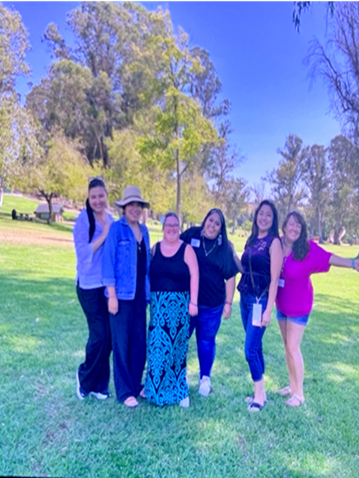
Director of Equity & Engagement Scope and Responsibilities
Oversight and Supervision of the Equity and Engagement Unit:
DEIB/LACC – Abi Andrade & Anaid Carreno
Communications Specialist – Geri Audette
Consumer Advocate – Ellen Sweigert
Person Centered Thinking Coordinator – Carrie Brown
Effective October 2025, The DEI Unit 1-40 caseload will transfer under my supervision

Slide 10
Strategic Focus Areas (2024-2026)
1. Diversity , equity, inclusion and belonging
2. Person-Centered Thinking (PCT)
3. Advocacy
4. Communications

Slide 11

1 DIVERSITY, EQUITY, INCLUSION & BELONGING STRATEGIC PLAN 2024-2026
Key Focus: Equitable Access for All
Remove barriers that prevent minority groups from using services
Support in preferred languages with translation & interpretation
Culturally responsive services that respect family values & traditions
Person-centered approach that prioritizes individual needs and voices
Embed inclusion so services reflect the diversity of our communities

Slide 12
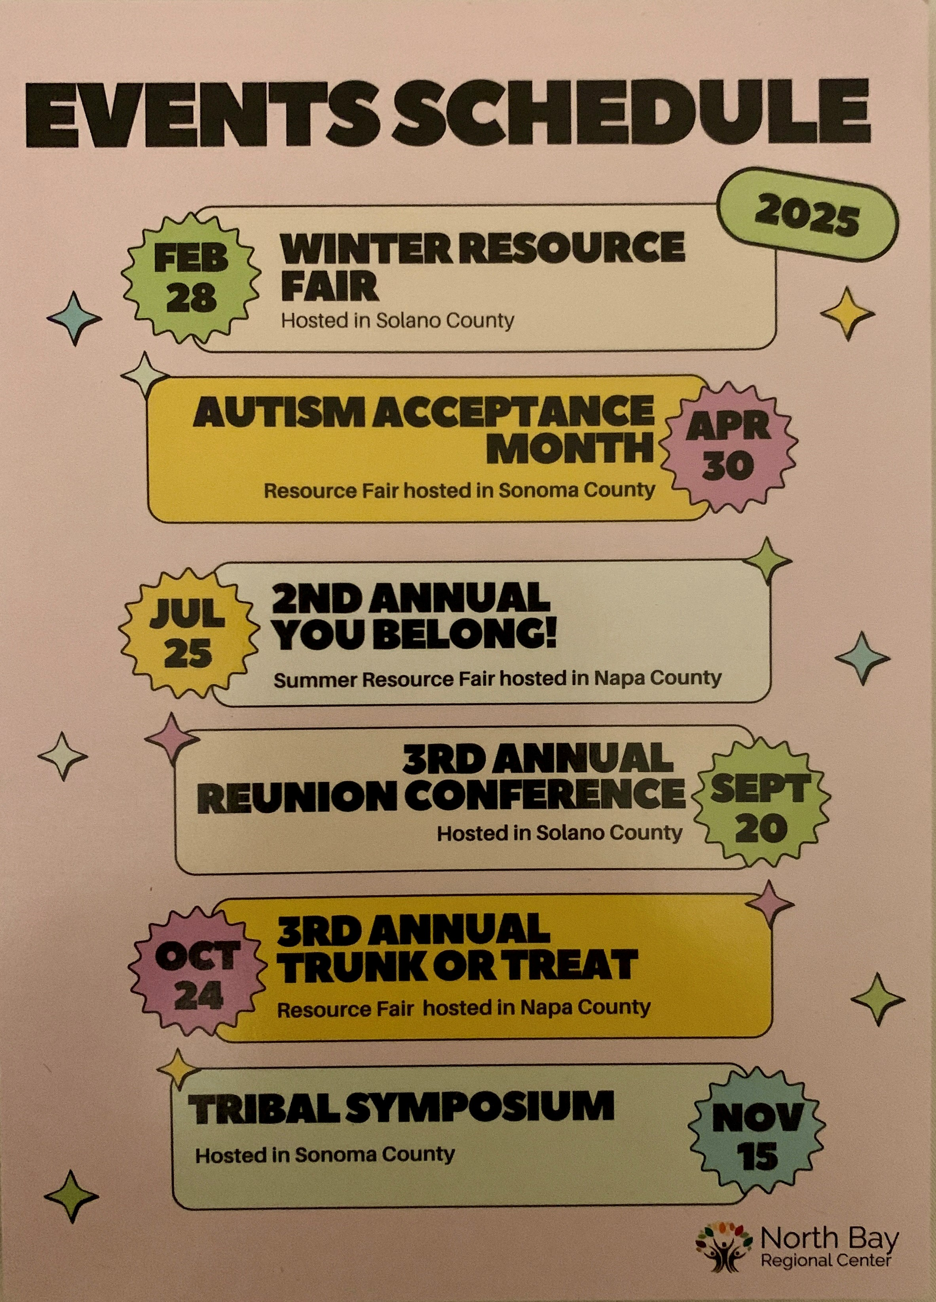
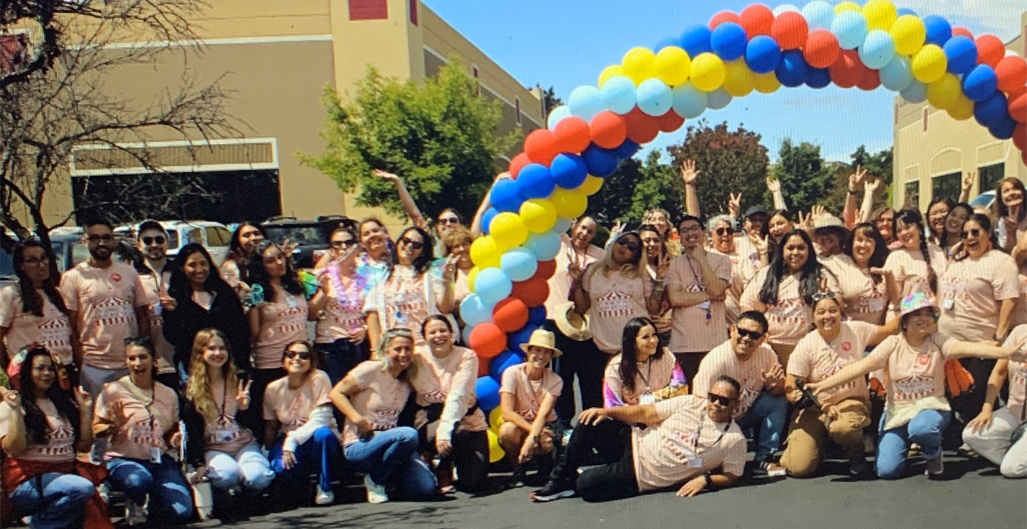

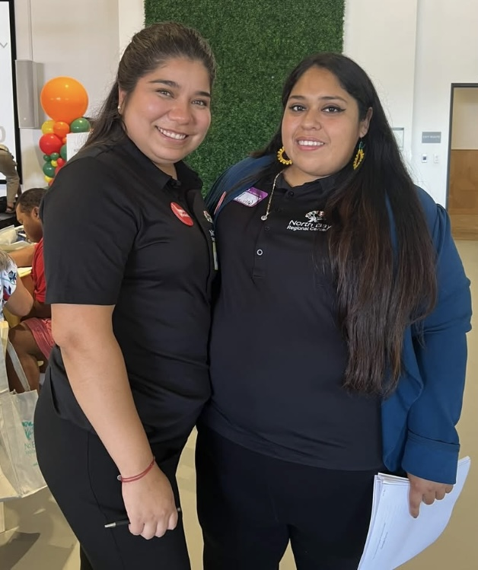
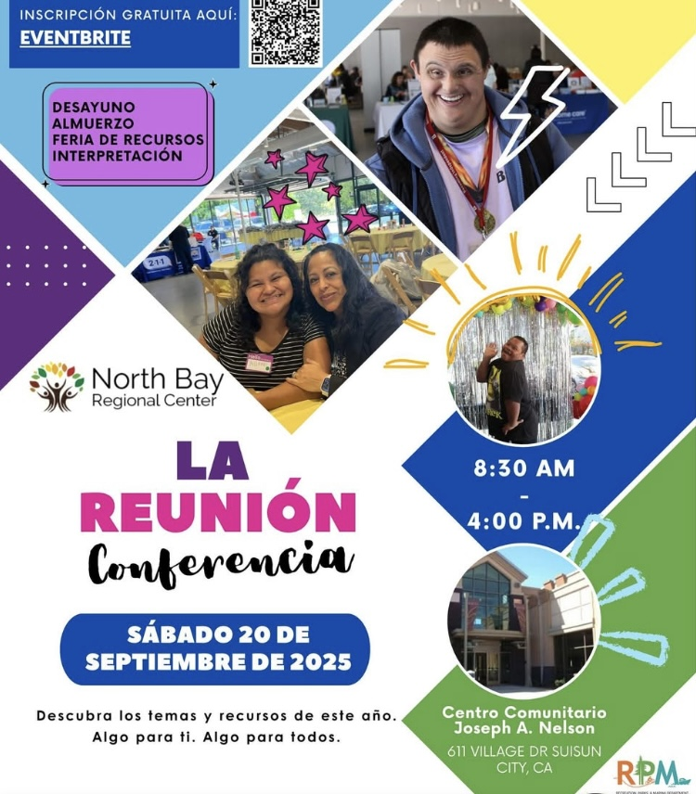
DEIB EVENTS 2025

Slide 13
Person-Centered Thinking 2024-2026 Strategic Plan
Objective:
Internal policy development; cultivate a person-centered organizational culture through cross-departmental collaboration.

Slide 14
Person-Centered Achievements so far…
PCT Steering Committee (17 members) formed with representation from multiple departments, including Human Resources, Intake, Clinical, and Early Intervention. QA, Case Management, Resource Dev
PCT Coordinator Carrie Brown hired on July 16, 2025.
6 certified PCT trainers and 14 PCT coaches in place.
3 out of 6 Cultural Leadership change PCT all-day trainings completed.75% of NBRC staff have completed the 2-day PCT training.
One-Page Description activity introduced and supported.PCT Coordinator attends Unit Meetings to facilitate the One-Page activity.
Formation of a cohesive PCT team including the coordinator, coaches, and trainers to clearly define roles and scope, and to provide ongoing training and coaching support to all staff.

Slide 15
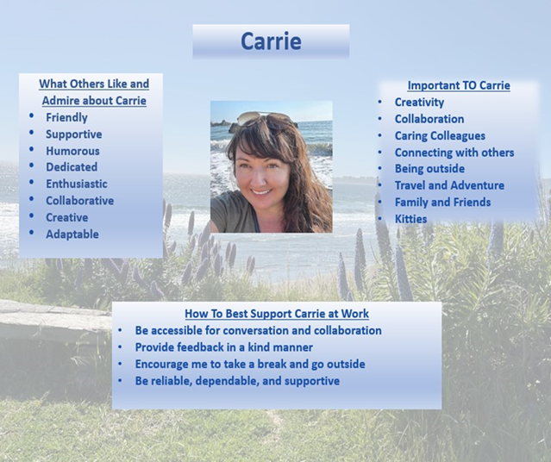
One Page Description
Claudia’s OPD
Carrie’s Brown OPD

Slide 16

ADVOCACY 2024–26 Strategic Plan Strengthening Self Advocates.
Focus: Foster self-advocacy, leadership, and interconnectedness among individuals served by NBRC and their communities.
Goals
Amplify Voices Create space for self-advocates and community members to share perspectives and influence change.
Track Growth Build a simple tool to measure progress and impact in self-advocacy.

Slide 17
ADVOCACY STRATEGY
Building Self-Advocacy
Expand Advocacy Presence & Influence
Form a Self-Advocacy Committee
Partner with local organizations to elevate advocacy efforts
Measure Self-Advocacy Growth
Develop a simple self-advocacy tool (survey, checklist, stories)
Gather feedback from self-advocates
Share progress reports with community & stakeholders

Slide 18

Communications and Outreach 2024-2026 Strategic Plan
Key Focus: Strengthen and streamline communication systems so that staff and community feel informed, connected, and aligned with NBRC’s mission and priorities.

Slide 19

Communications Project
Equity & Engagement Unit 1

Slide 20
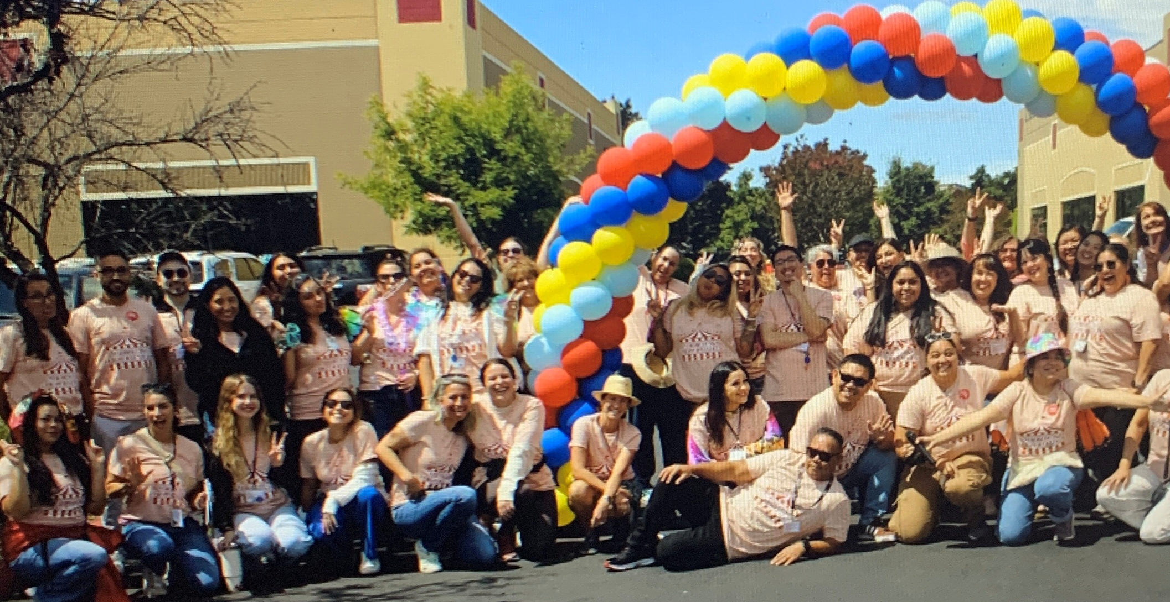
WE BELONG!
CHECK OUT A VIDEO OF THE EVENT HERE!

